Slide 1

Beth Lord’s Blog
How Easy It Is To Make A Book In Thirty Minutes
Give The Gift That Keeps Giving©

Slide 2
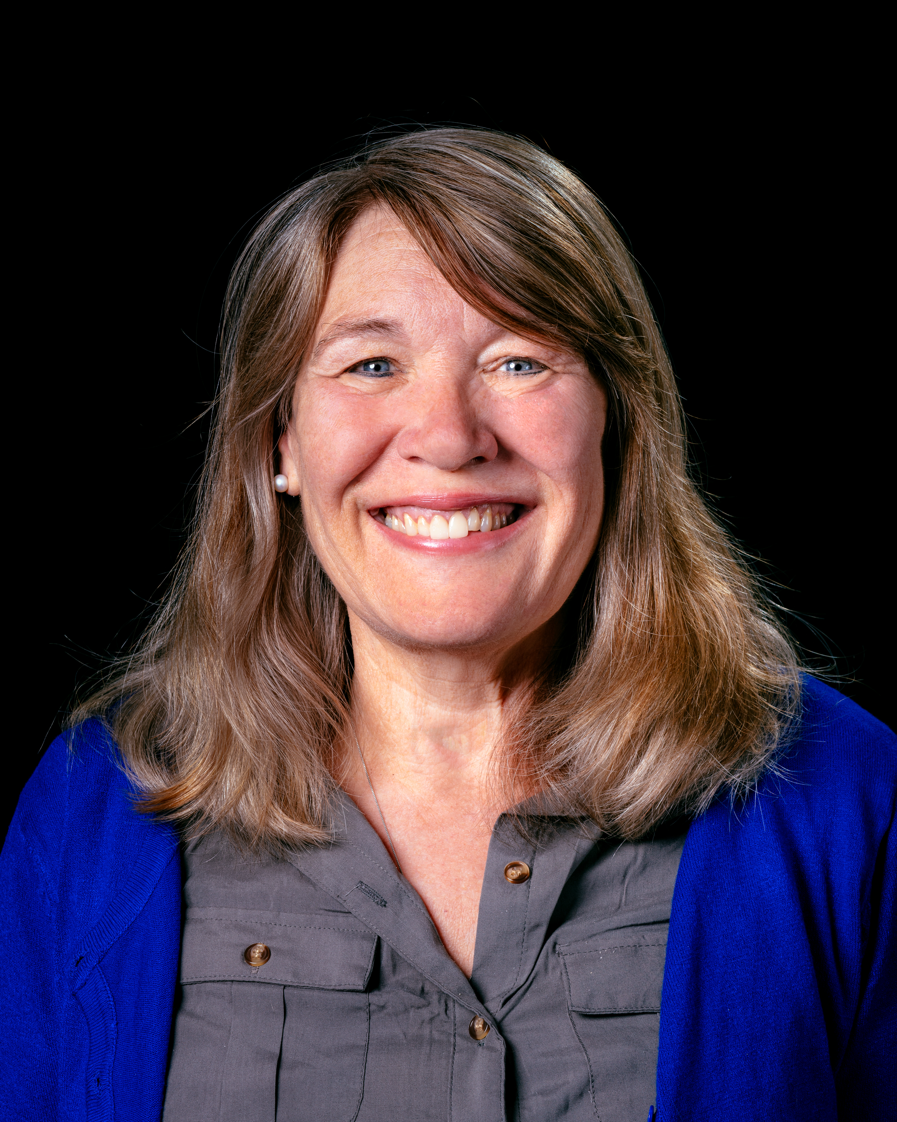
Hi,
I’m Beth.

Slide 3
Chapter One
Ask Questions
Look At Photos
Record The Story
Out Of Six Chapters
to
Demonstrate
How Easy It Is To Make A Book In Thirty Minutes

Slide 4
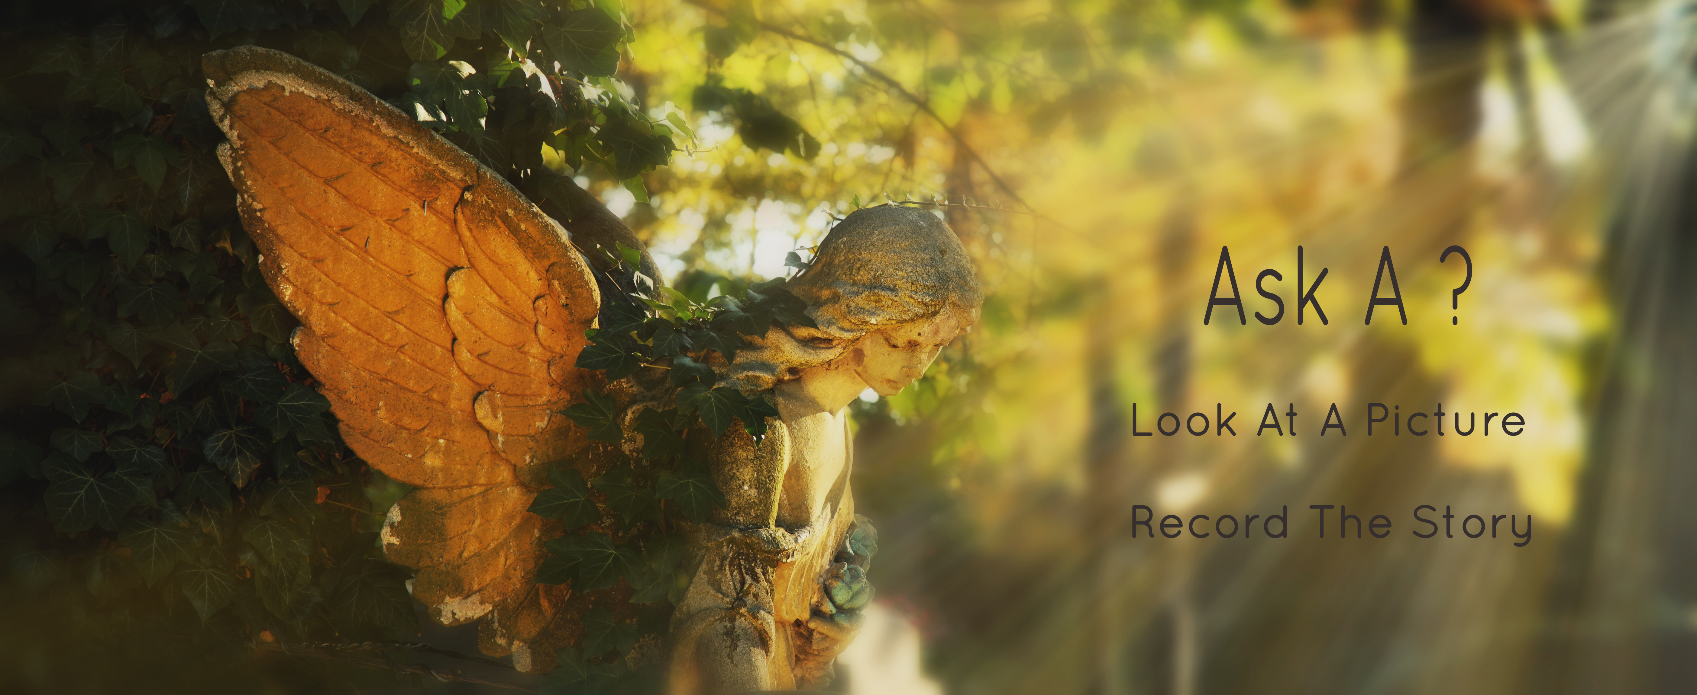

Slide 5


Slide 6

You Are The

Slide 7
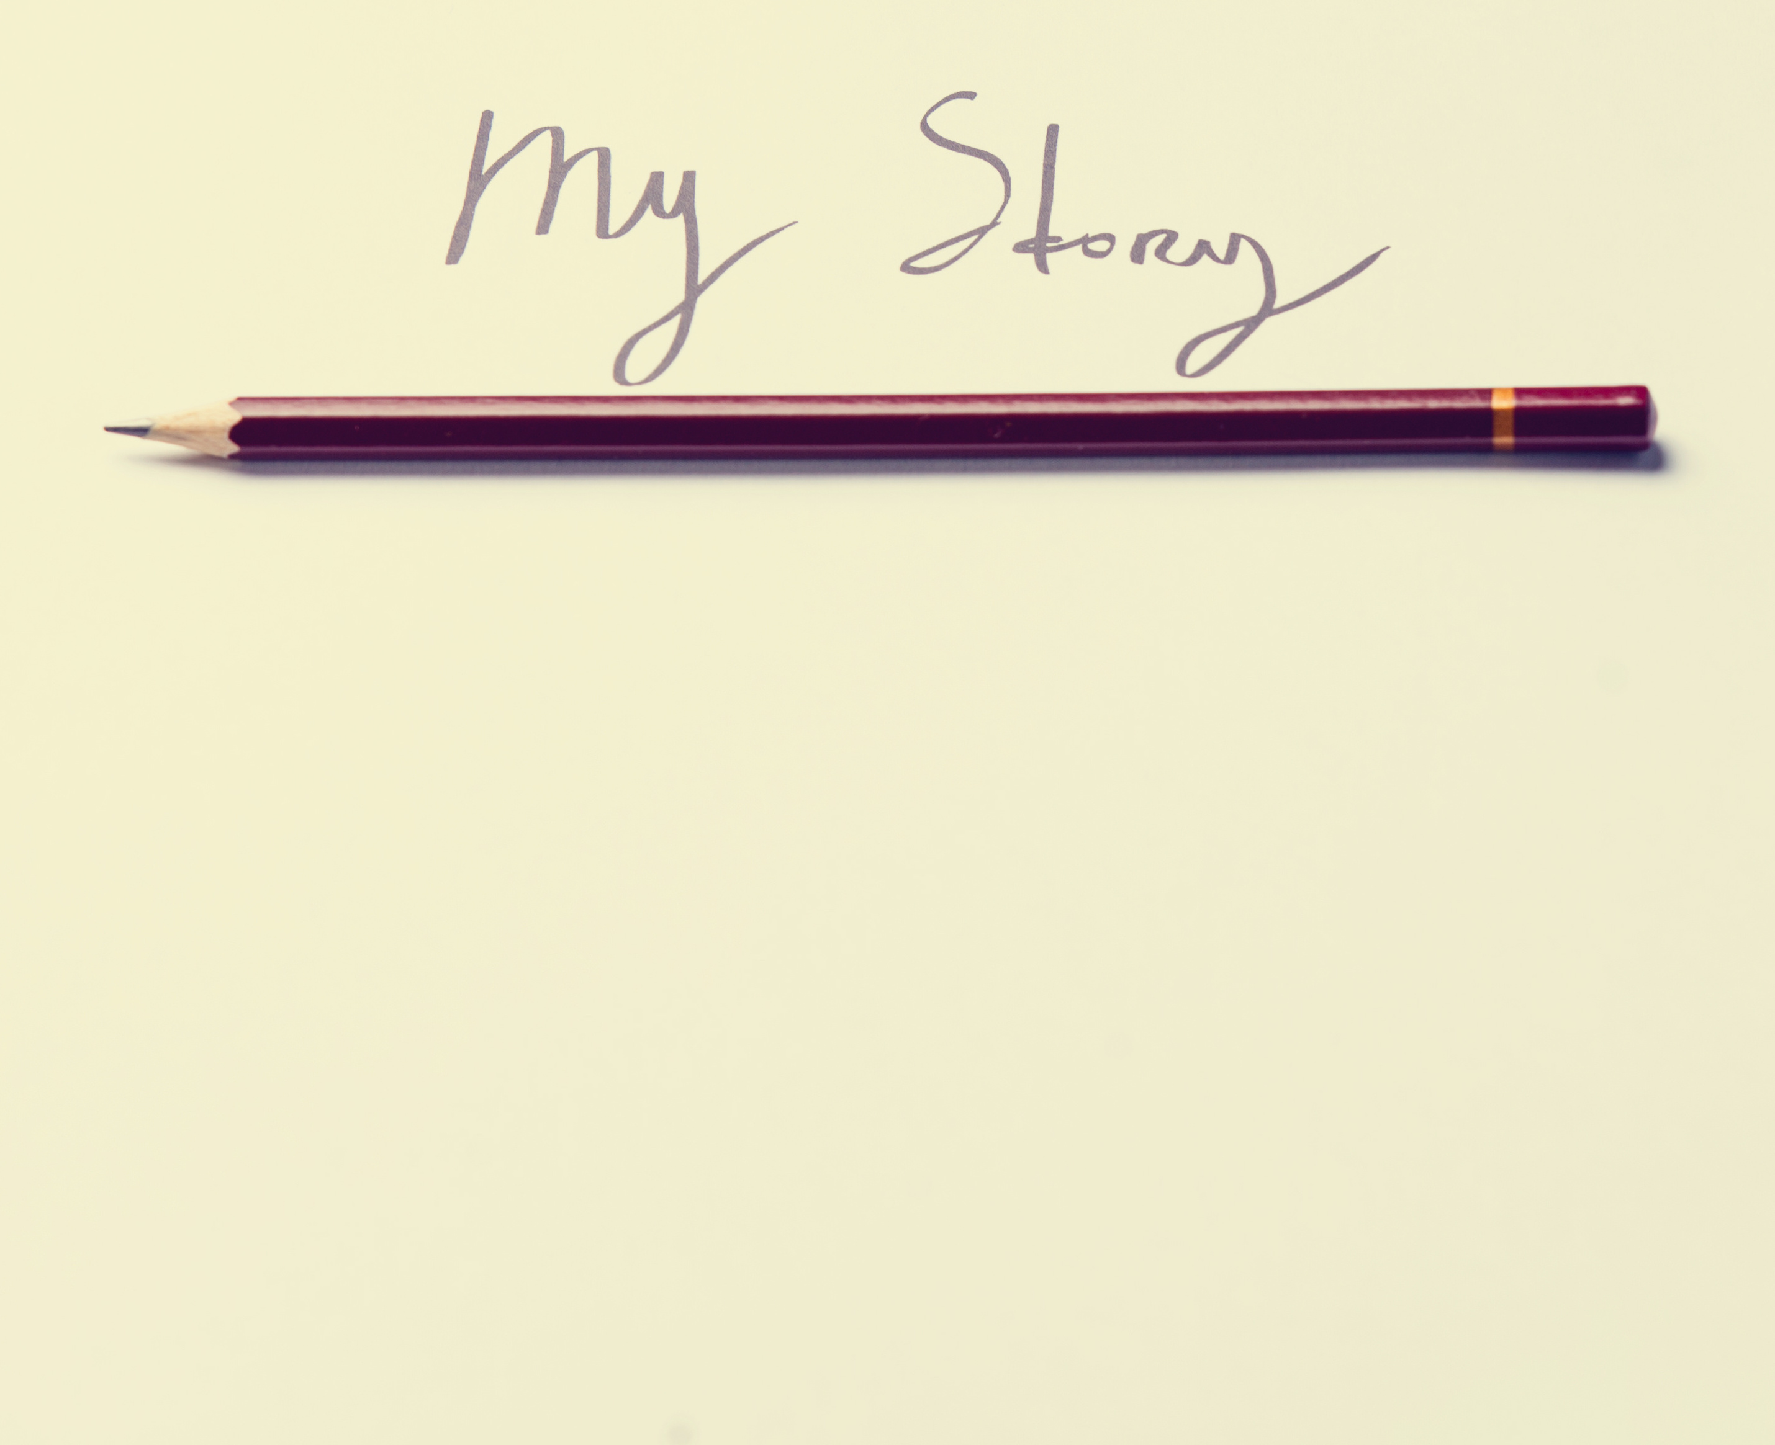

Slide 8


Slide 9


Slide 10


Slide 11
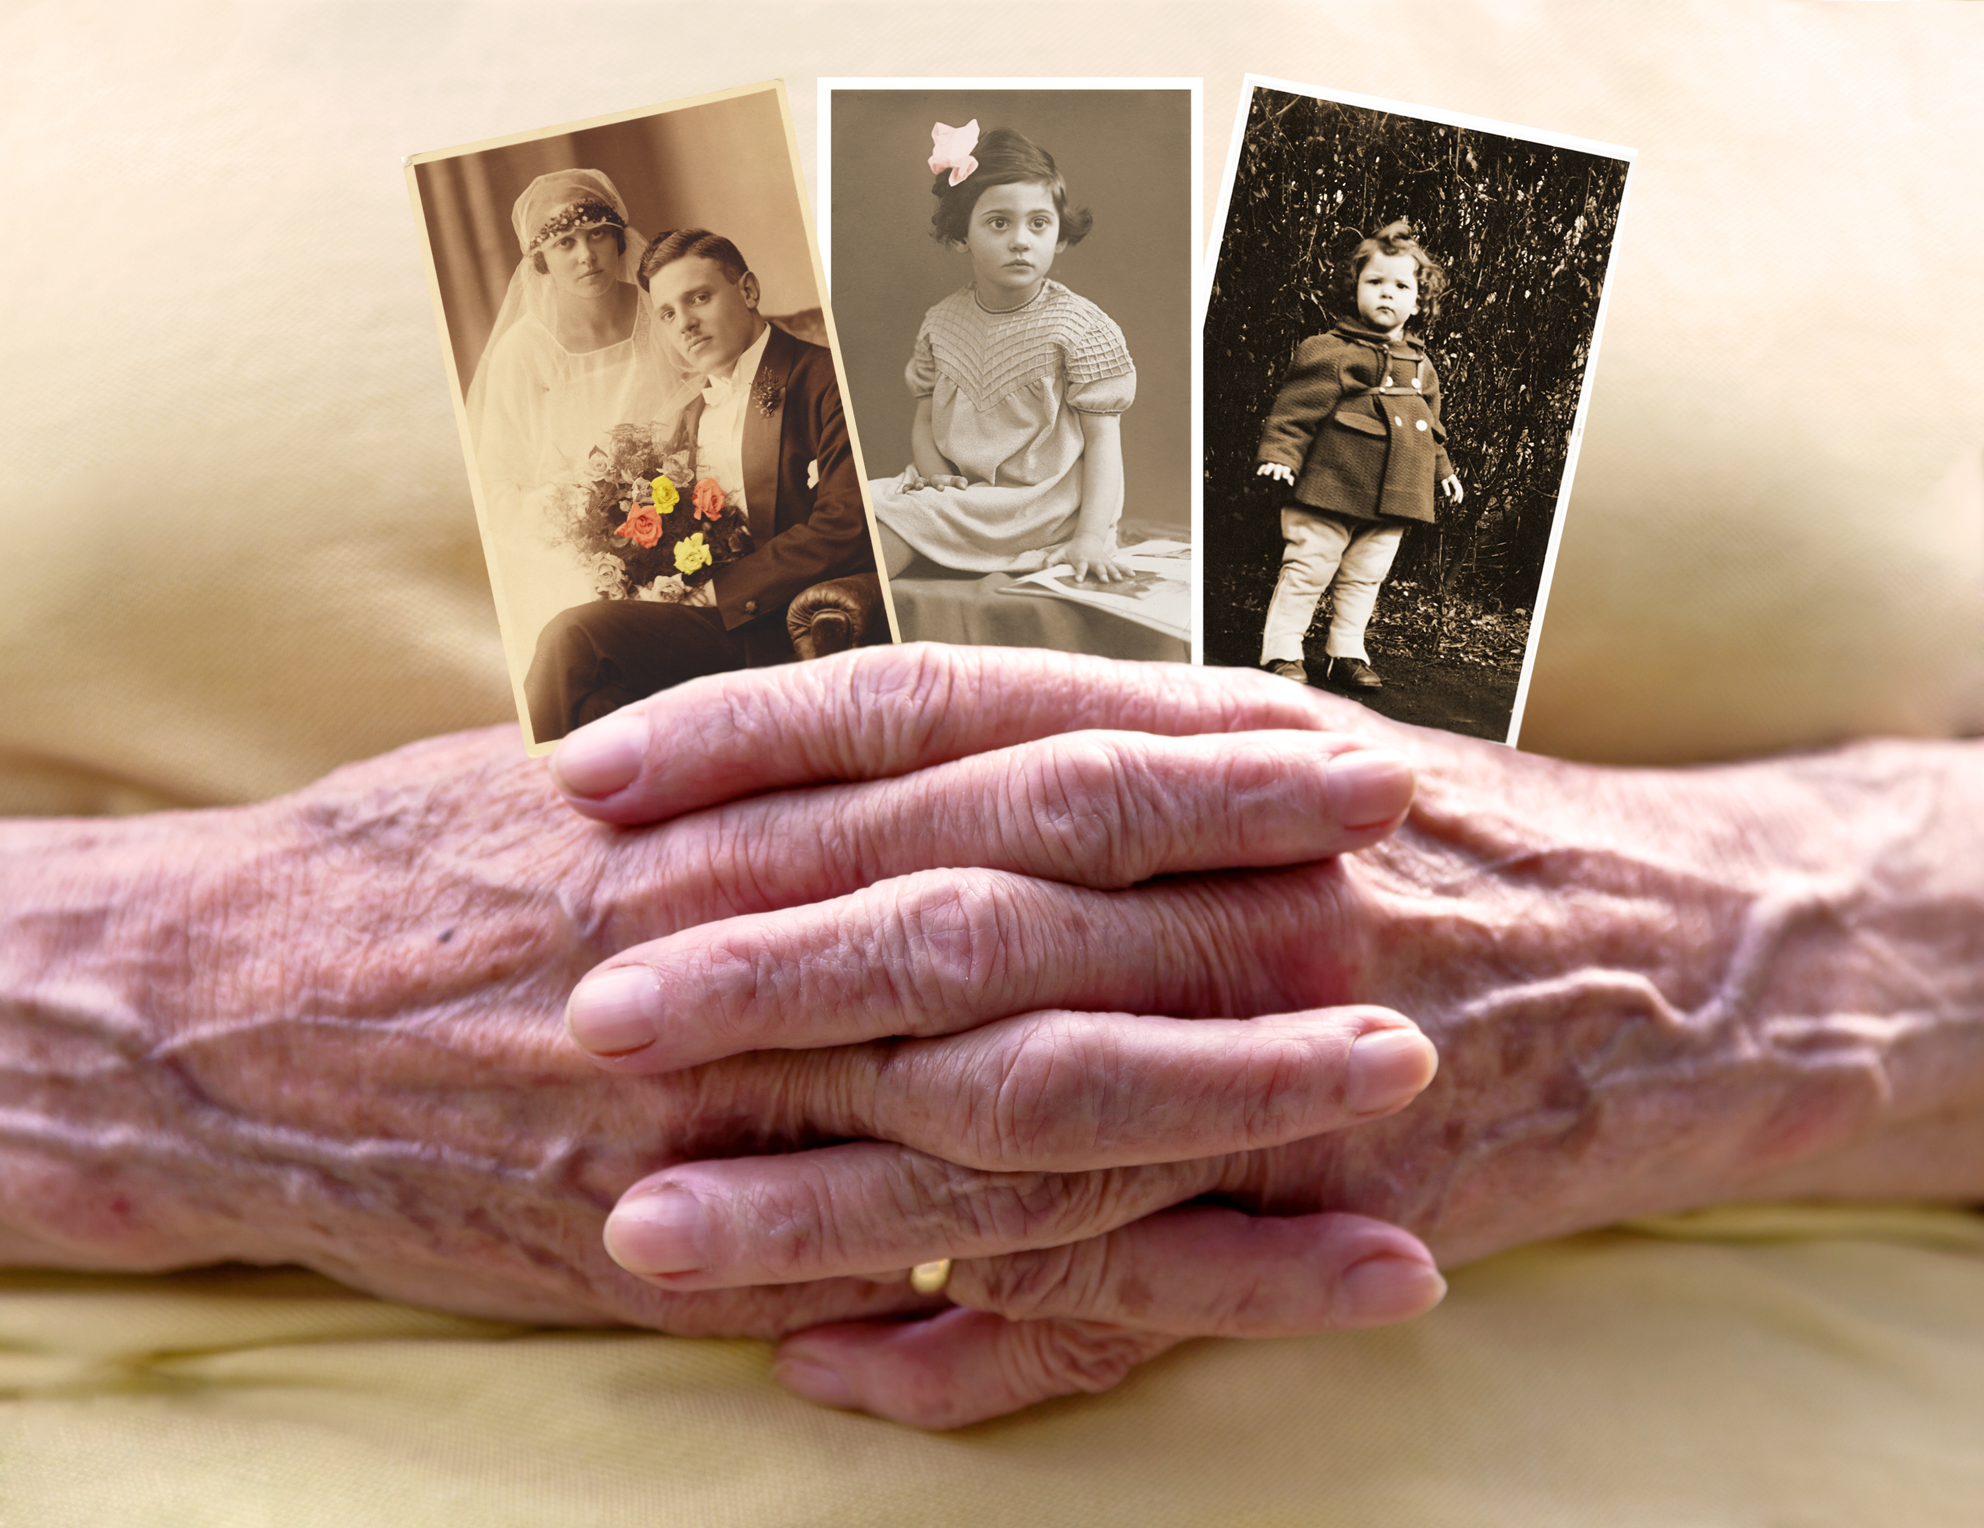

Slide 12
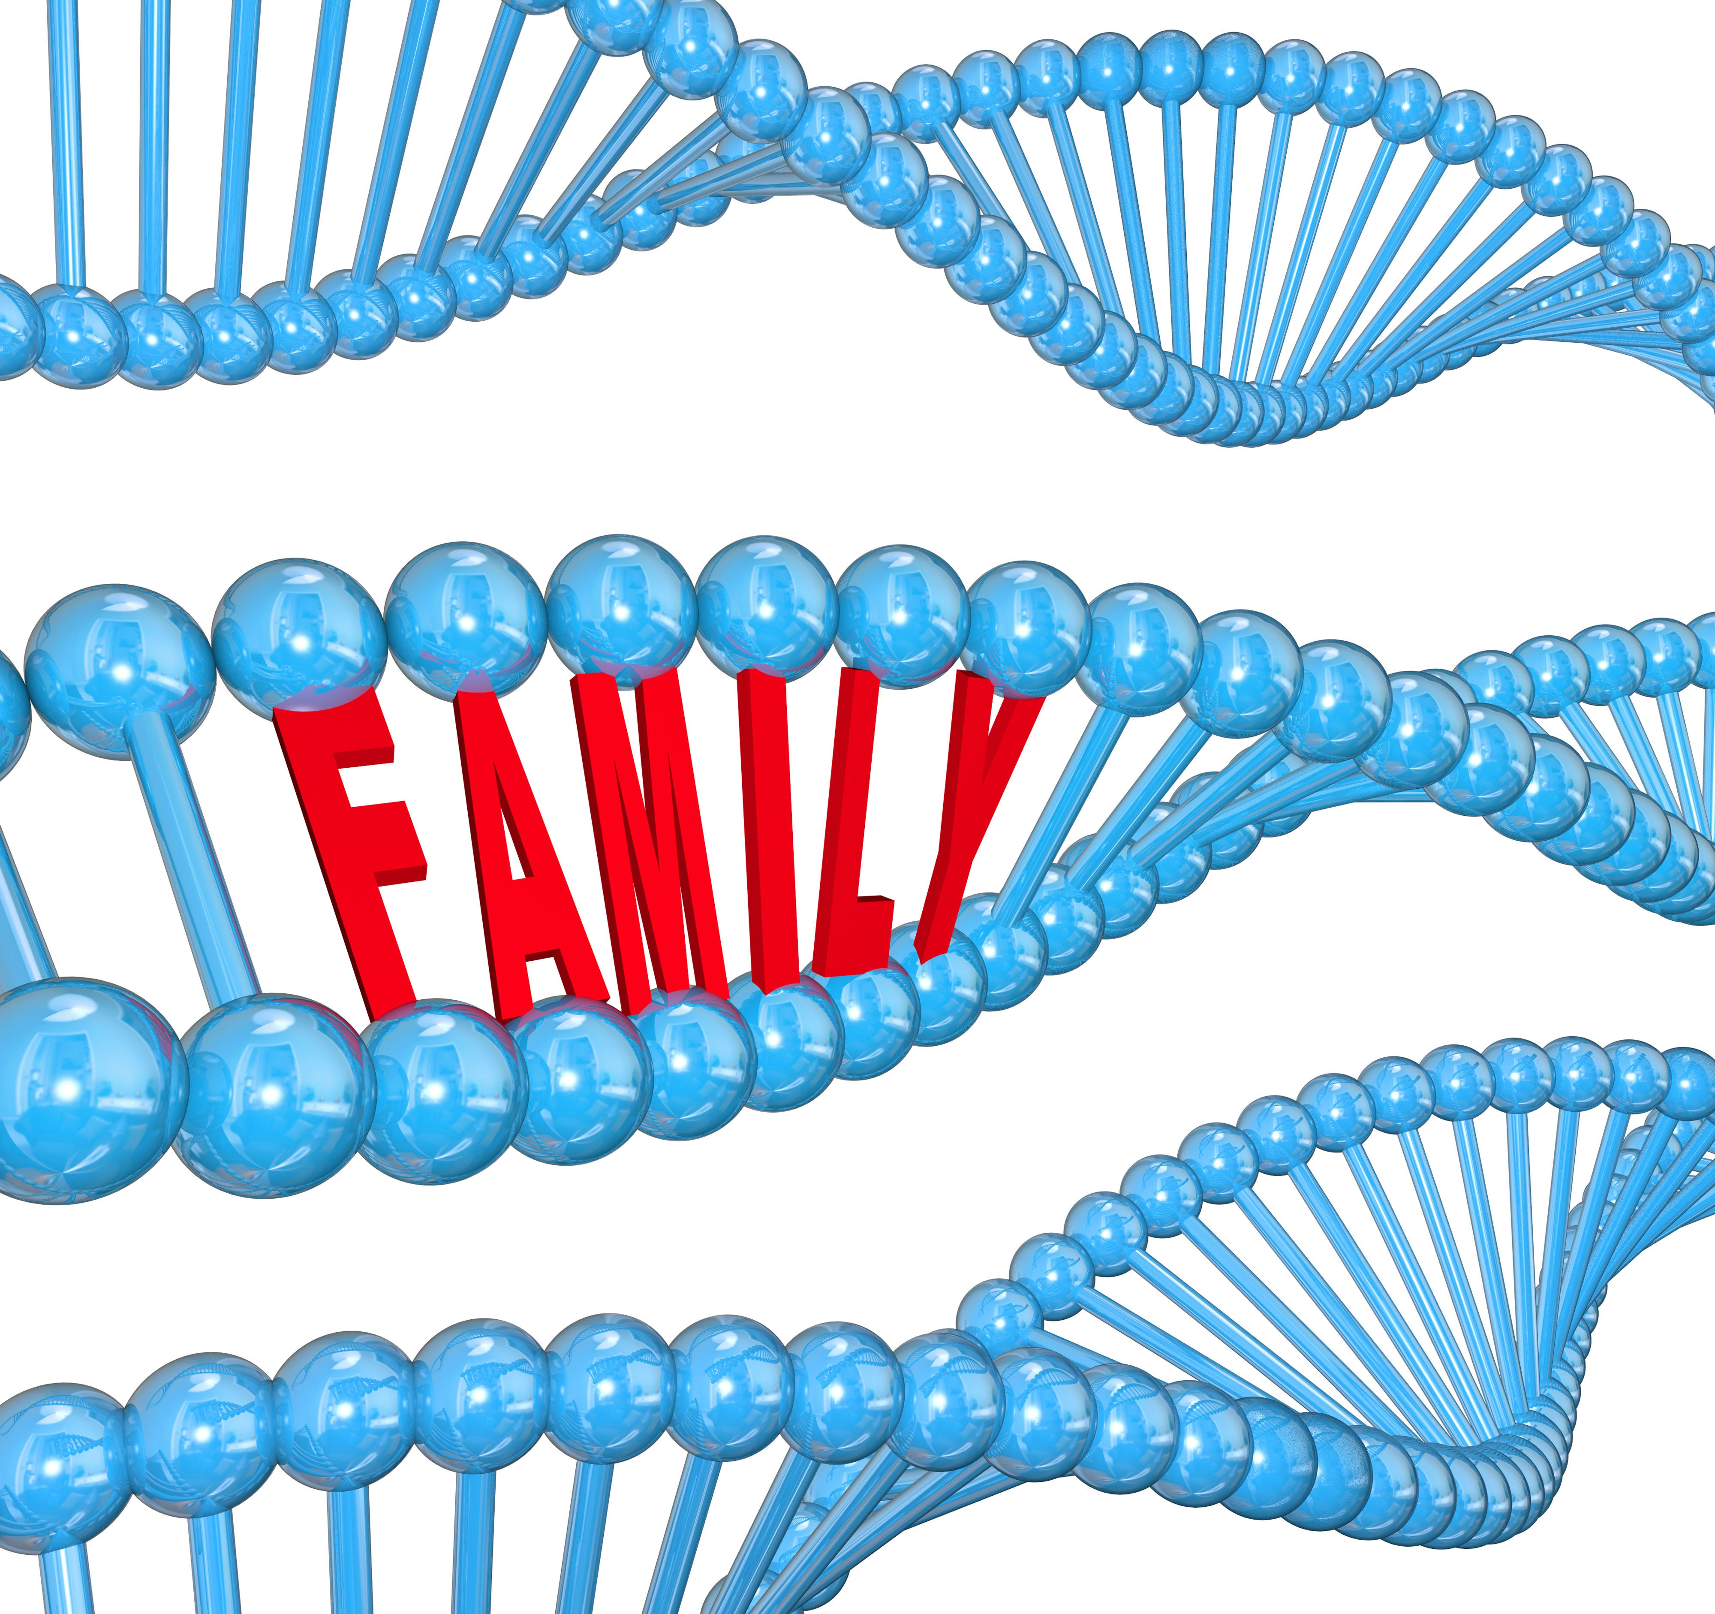

Slide 13
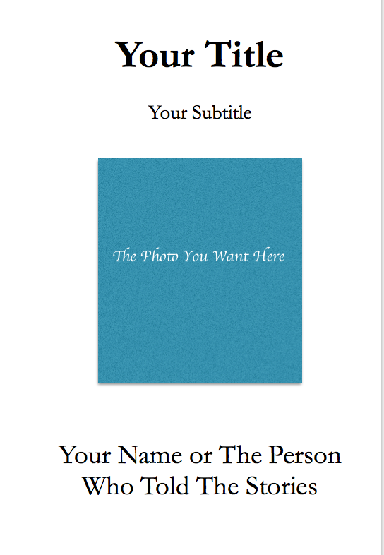

Slide 14


Slide 15


Slide 16
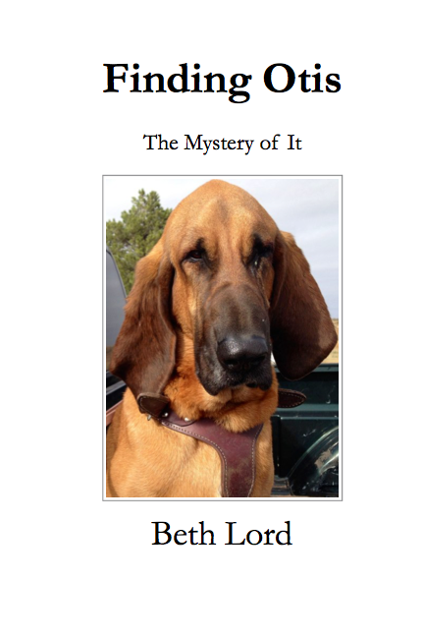
I came back to
the farm
in the fall of
2014,
after walking
The Camino de Santiago
a second time.
I had this
experience
with Otis.
After Otis,
I knew I had
to help people
turn their stories
into books

Slide 17

If you’ve lost a loved one,
this is a
reading and writing journal
that can help you
write or record
your stories.
Keep it as is or
let us turn these
stories into books.

Slide 18
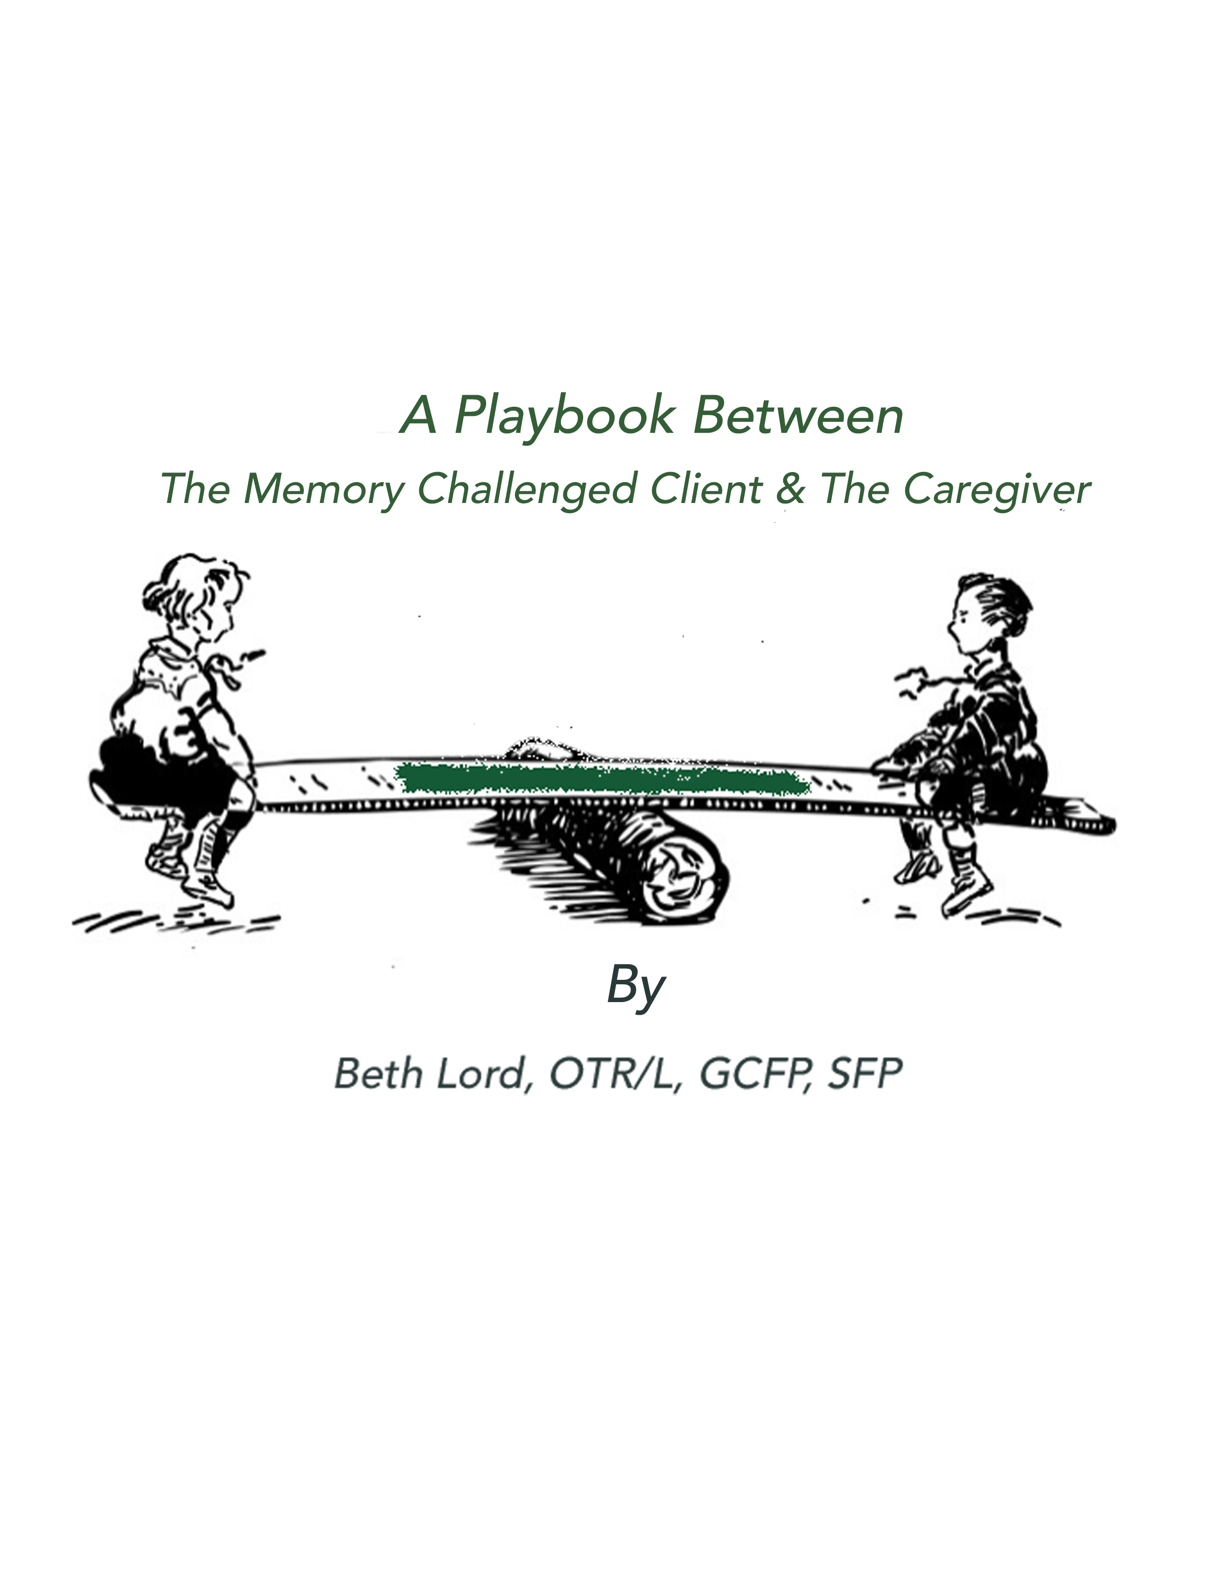
I had to write this for
my client, Peter.
He has come so far with understanding his head injury
and his memory.
I’d like both clients & caregivers to
have this same opportunity.
50 Simple
“Mind Alternating Fun Activities To Do.”

Slide 19

After I was fired in 2011,
Sammy (my youngest daughter) & I traveled all over Spain. It’s
when I first learned of “The Camino”
and where we met Sergio &
Fernando from Italy.
We became long-lasting friends. They have this Spa,Fernando designs amazing luxury bed sheets and Sergio is an engineer who supports all the amazing creativity of their partnership.
I saw them again in 2015 on my way to walking my third Camino and many more books are planned with this dynamic duo.

Slide 20
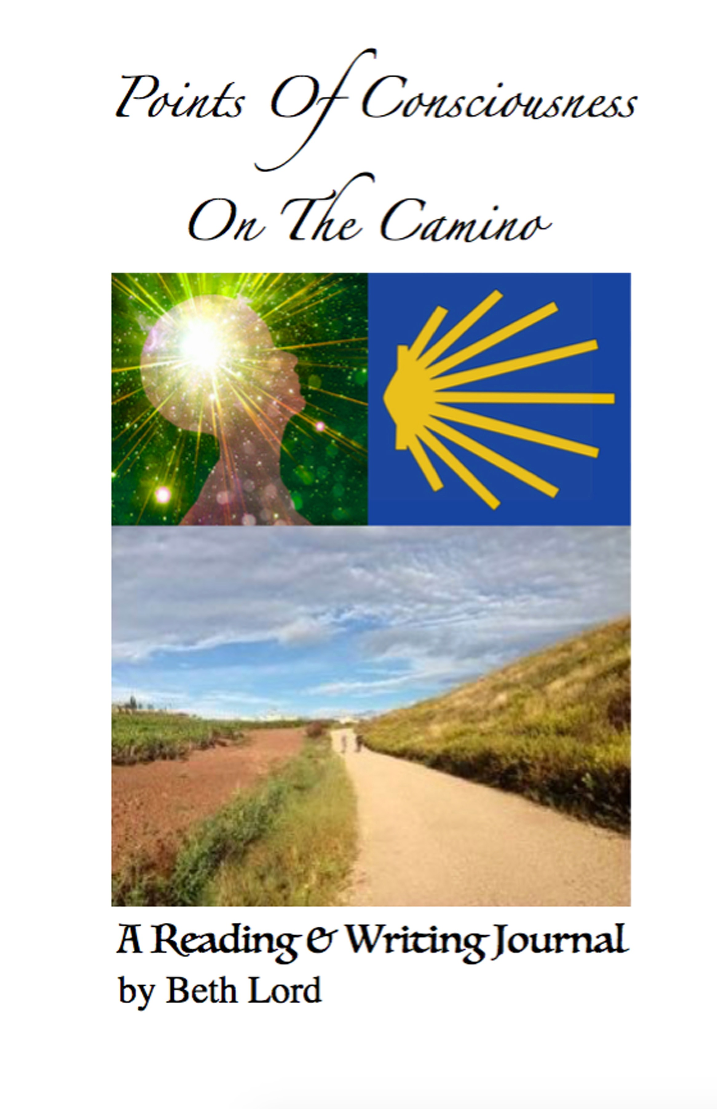
Ny very first book in 2013,
I first wrote calling cards
to help with telling your stories, like
Telling Your Mother’s Story
My very first book in 2013,
after I walked
The Camino de Santiago
for the first time.
It changed me forever and my life practices.
I rewrote it in 2016 for
pilgrims and my fourth time on
The Camino de Santiago

Slide 21
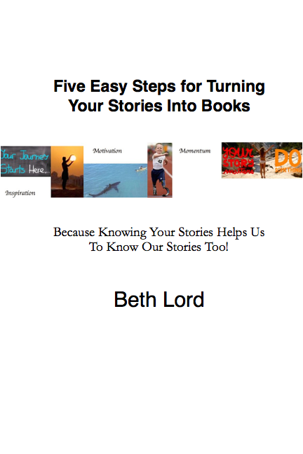
A Gift For You
so you
can

Slide 22


Slide 23
Beth
beth@bethlord.com
Beth Lord’s Write Heart Memories®
Twitter: @BethBLord
Instagram: Writeheartmemories
www.linkedin.com/nhome/?trk=
Facebook:
https://www.facebook.com/TurnYourStoriesIntoBooks/
The Power Of You And Your Stories In Books.

